Slide 1

Amazon Sale Analysis
By : Bhimansh Garg

Slide 2

Introduction
The objective of this project is to analyze sales trends and identify key metrics to improve sales management and distribution methods for Amazon sales data

Slide 3

About Dataset
The dataset contains sales records including attributes like Region, Country, Item Type, Sales Channel, Order Priority, Order Date Units Sold, Unit Price, Total Revenue, and Total Profit.

Slide 4

ETL Process
Extract: Data was extracted from a CSV file containing Amazon sales records
Transform: Converted 'Order Date' and 'Ship Date' to datetime format, extracted month and year from 'Order Date', and created a 'Year-Month' column.
Load: Loaded the cleaned and transformed data into a DataFrame for analysis

Slide 5
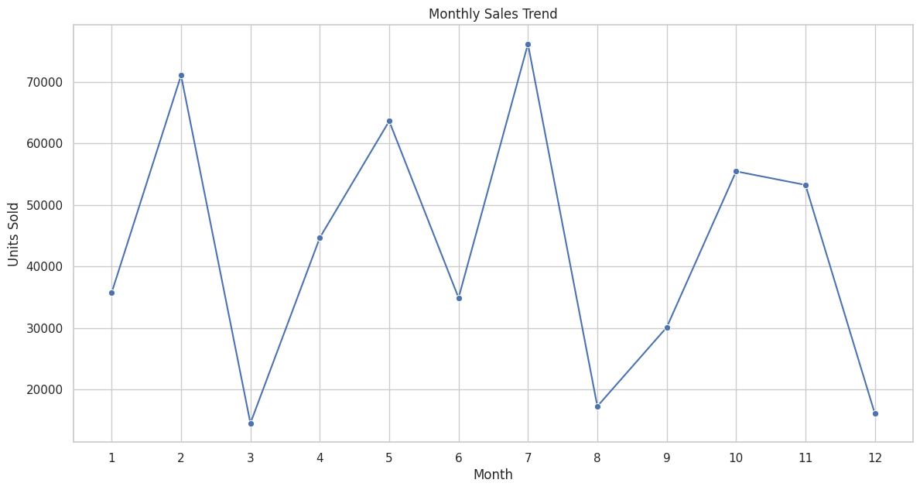
Monthly Sales
Sales tend to peak in certain months, indicating seasonality in purchasing behavior.

Slide 6
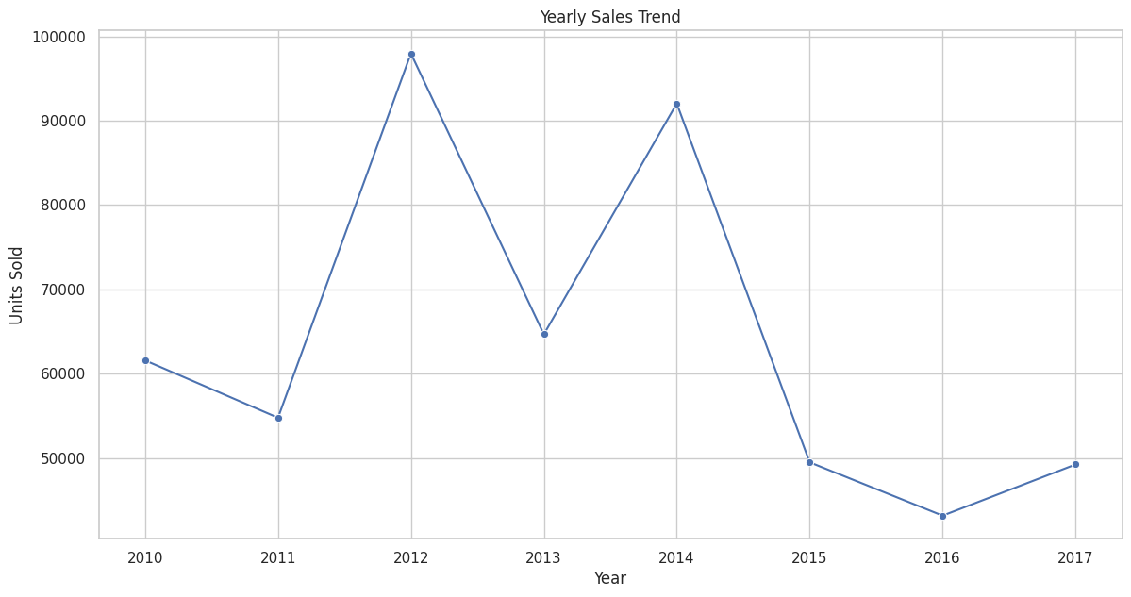
Yearly Sales
Yearly sales have been on an upward trend, indicating overall growth in sales volume over time

Slide 7
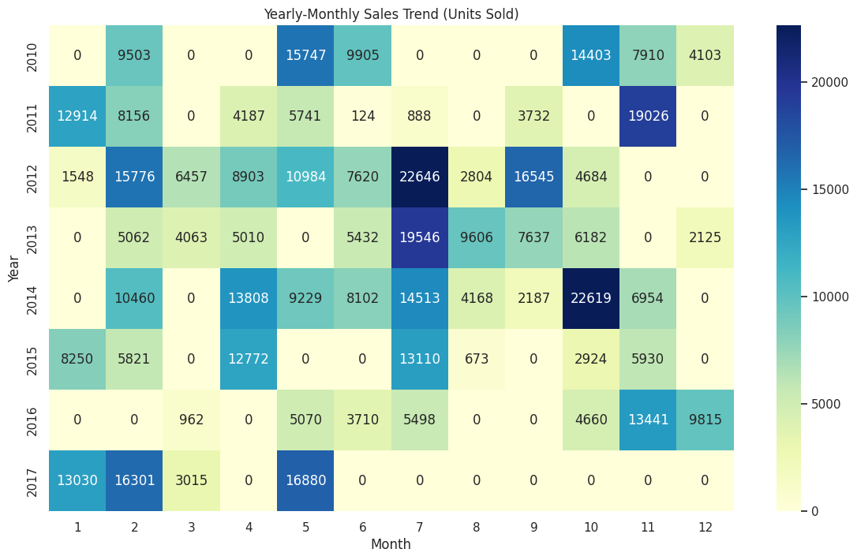
Yearly-Monthly Sales
Certain months show consistently higher sales across multiple years, suggesting seasonal trends.

Slide 8
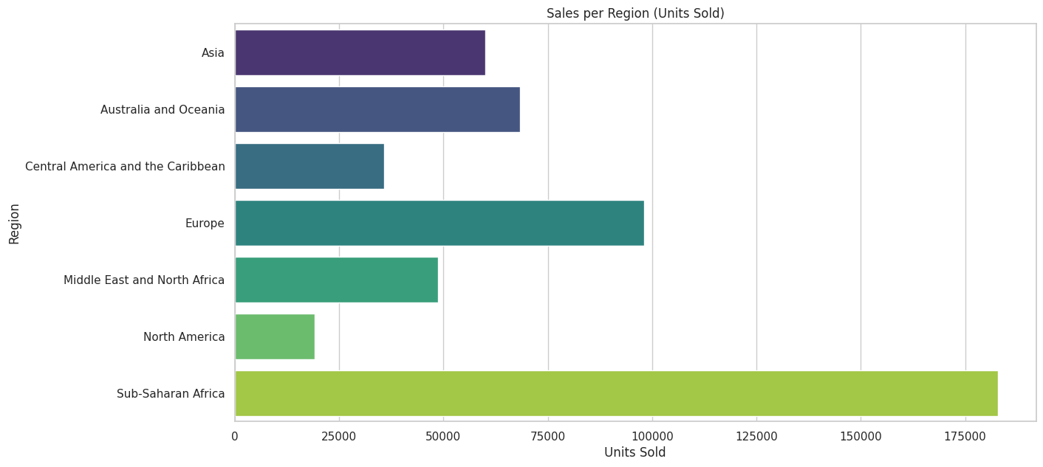
Sales per Region
Regions like North America and Europe have the highest sales volumes, indicating strong market presence.

Slide 9
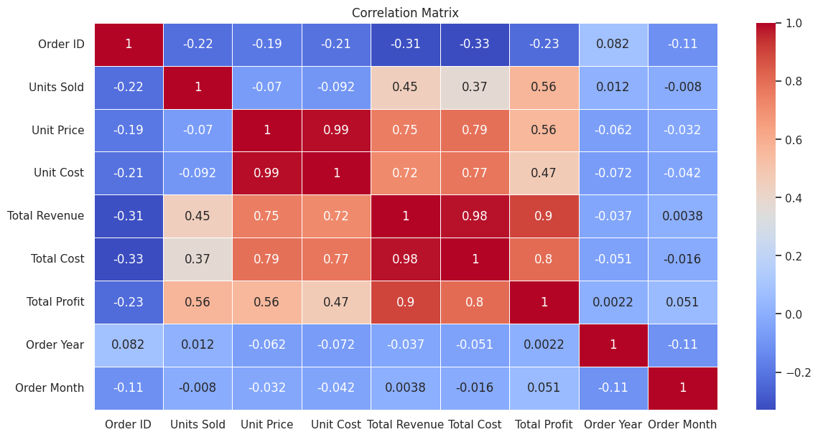
Correlation Analysis
Total Revenue is strongly correlated with Units Sold and Unit Price, indicating that higher sales volumes and prices lead to higher revenue.

Slide 10
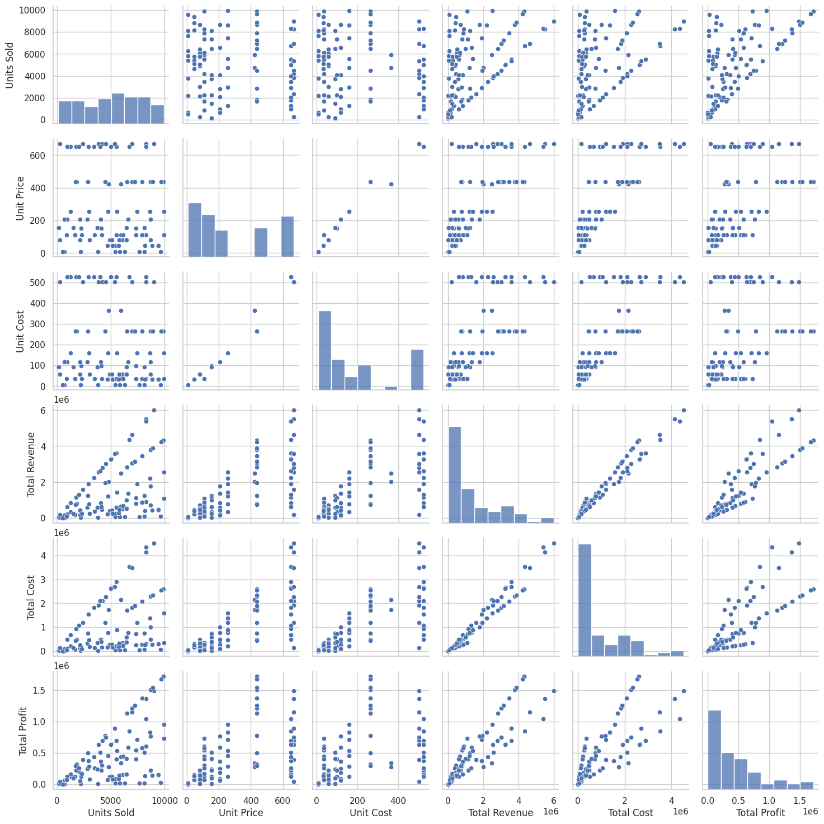
Correlation Analysis
The pair plot reveals that higher Units Sold generally leads to higher Total Revenue and Profit.

Slide 11


